Slide 1
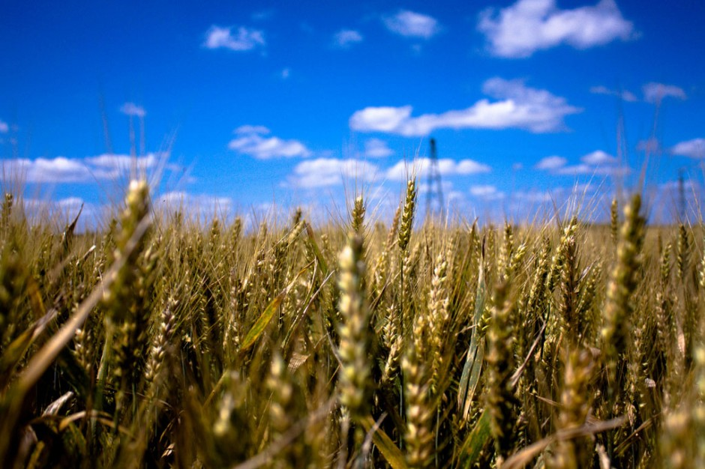
Intensive Agriculture

Slide 2

Stop prejudges …

Slide 3
Plan
Introduction
I Intensive Agriculture
1) Definitions
2) Advantages
3) Disadvantages
II Example of breeding : battery cages
1) Advantages
2) Disadvantages
III Example of growing : GM Crops
1) Production of GMOs is always rising
2) Advantages/Disadvantages
3) GMOs at the heart of global issues
Conclusion
Sitography

Slide 4
Introduction
We can talk about « Intensive Agriculture » since the Green Revolution (1940-70) which permit to saving over a billion people from starvation thanks to :
development of high-yielding varieties of cereal grains
expansion of irrigation infrastructure
modernization of management techniques
synthetic fertilizers, and pesticides
This news form of agriculture is quickly became essential to the society.
Spite of all the sciences progress, we have always over 868 million people still suffering from "chronic hunger” in 2011.

Slide 5
1)Definition
Intensive Agriculture :
More chemical product : fertilizer, herbicides, fungicides,…
More and bigger material and machine
Bigger capital
In order to rising yields and feed people

Slide 6
2)Advantages
Bigger yields from land available
Fewer workers needed
Animals lead happier lives
Soil structure is better
Fewer blemishes on crops
Use of hormones increases meat production
Intensive farming
Organic farming
Produce is cheaper
aids in solving the worldwide hunger problems
More birds and insects
Less harmful to environment
Antibiotics use keeps animals healthy
Sustainability over the long term

Slide 7
3)Disadvantages
More expensive
More blemishes on crops
Chemicals stay in soil
Man-made chemicals used
Intensive farming
Organic farming
Animals live in crowded conditions
insufficient yields
Natural predators destroyed
Chemicals wash into rivers
More farm workers needed
Forests are destroyed to create large open fields

Slide 8
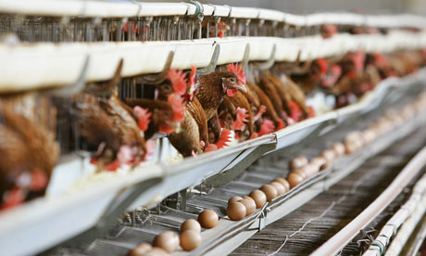
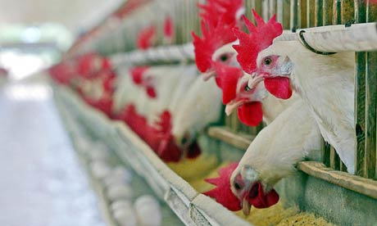
III Example of breeding : battery cages
In 1990, North and Bell reported that 75% of all commercial layers in the world and 95% in the United States were kept in cages.
over 60% of the world’s eggs are produced in industrial systems, mostly using battery cages (2004).

Slide 9
1) Advantages:
Poultry (with pig) production is a vital part of UK agriculture and accounts for around 1/5 of total agricultural output.
Eggs are cleaner
Less feed is required to produce a dozen eggs
Better yield than conventional farming

Slide 10
2) Disadvantages:
Poultry farms can affect the environment through the release of pollutants :
Ammonia
Nutrients from manure, litter and slurry
Effluent discharges
Dust
Odour
Noise

Slide 11
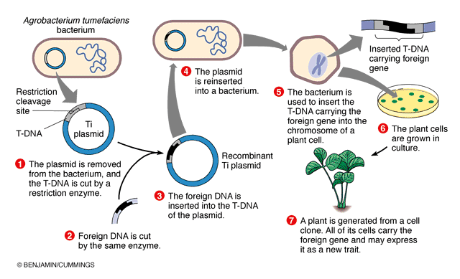
II Example of growing : GM Crops
Scheme of GMOs process

Slide 12
GMO crops are the first intensive form which contributes to more sustainable land use in the long term.
Today, GM plants represent an important part of growing especially some plants like soy, cotton, maize…
 | Area worldwide | Area GM | Proportion GM
Soy | 90 | 69 | 77%
Maize | 158 | 42 | 27%
Cotton | 33 | 16 | 48%
Rapeseed | 31 | 6,4 | 21%
Sugarbeet | 4,4 | 0,5 | 11%
Cultivation worldwide in millions of hectares (2008) Source : ISAAA

Slide 13
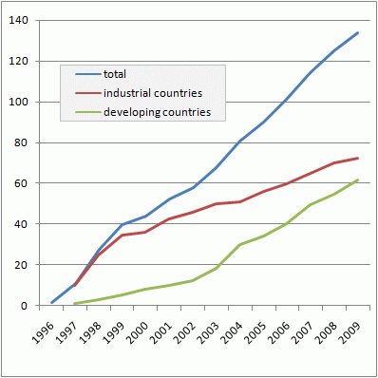
1) Production of GMOs is always rising
Worldwide Cultivation areas with genetically modified plants
(1996 – 2009), in millions of hectares.
Where an increase in food production is urgently needed and where crop yields are significantly lower, biotechnology have greatest impacts …

Slide 14
2) Advantages/Disadvantages
Less pesticide is needed to be used due to insect pest resistant plants.
Higher crop yields
Less deforestation needed to feed the worlds growing
Decrease in food prices
More nutritious
Less factory additives needed.
Reduced energy needs to produce GMO crops.
Taste of GMOs are not as good or "natural”
Spread of new, more resistant "super pests” or “super weed”
Unharmonized test-, and safety standards around the world.
new allergy types may develop.
Critics say GMOs may cause health problems.

Slide 15
3) GMOs at the heart of global issues
According to the European Commission, global agricultural production needs to be doubled by 2050 to feed the world.
How double global production with :
less water
fewer pesticides
less greenhouse gas emissions
Less fields ?
This question stay today without answers but one things is sure, we can’t renounce to GMOs.

Slide 16
Conclusion
At the beginning, Intensive agriculture was essential to feed the world in spite of impacts in environment.
Today, we do not have oppose intensive agriculture to organic agriculture but associate them to sustainable agriculture.
To future, it is our duty as agricultural engineer to cope tomorrow's challenges.

Slide 17
Sitography
http://www.eschooltoday.com/
http://www.actu-environnement.com/ae/dictionnaire_environnement/definition/agriculture_intensive.php4
http://encyclopedia.thefreedictionary.com/battery+farm
http://www.euractiv.com/cap/intensive-farming-ecologically-s-linksdossier-506029
http://animalrights.about.com/od/animalsusedforfood/g/What-Is-A-Battery-Cage.htm
http://organic.about.com/od/organicdefinition1/g/Genetically-Modified-Organisms.htm
http://www.wisegeek.org/what-is-intensive-agriculture.htm#slideshow
http://csanad.hubpages.com/hub/GMO-advantages-and-disadvantages
http://www.environment-agency.gov.uk/business/sectors/32795.aspx
http://organic.about.com/od/organicdefinition1/g/Genetically-Modified-Organisms.htm
http://www.plantphysiol.org/content/124/3/923.full
http://www.gmo-compass.org/eng/agri_biotechnology/sustainability/553.is_sustainable_farming.html
http://www.isaaa.org/purchasepublications/itemdescription.asp?ItemType=BRIEFS&Control=IB044-2012

